Slide 1
Income Analysis
Hetansh Patel

Slide 2
ABOUT Data
The dataset contains 16 columns.
Target filed: Income
The income is divide into two classes: <=50K and >50K
Number of attributes: 14 - These are the demographics and other features to describe a person
We can explore the possibility in predicting income level based on the individual’s personal information.

Slide 3
Data collection
Data Website: https://www.kaggle.com/datasets/wenruliu/adult-income-dataset/data

Slide 4
Pre-Processing

Slide 5
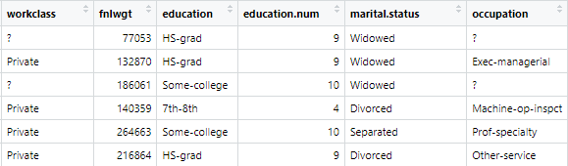
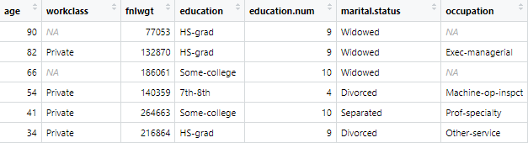

Pre-Processing
Before
After

Slide 6
Handling NA values
There were NA values in following columns:
Workclass
Occupation
Native Country
All of them are Character type. So we can’t just apply random values inside them. Its better to delete the entire rows rather than giving misleading information.

Slide 7
Data Exploration

Slide 8
Reviewing each feature
Age - Age of a Person
Workclasss –Type of workclass (i.e. Private, Government, Self-Employed, Others.
Fnlwgt – This stands for Final weight.(Represents the number of people that an observation in the dataset represents in a sample)
Education – Education level of a person
Education.num – Numerical representation of education level(Number of year of education)
Marital.status –Marital status of a person(i.e. Married,divorced, etc.)
Occupation – Type of occupation
Relationship – Relationship Status(i.e. Wife, Husband, Not in family, etc.)
Race – Ethnicity of Person
Gender – Gender of a person
Capital.gain – Financial gain of individual from investments or capital assets.
Capital.loss – Financial loss of individual from investments or capital assets.
Hours.per.week – Number of hours person works per week.
Native.country – Native country of an individual.
Income(Target Variable) - Incom of a person(less than or more than 50K)

Slide 9
Types
Age - Integer
Workclasss – Character
Fnlwgt –Integer
Education – Character
Education.num –Integer
Marital.status –Character
Occupation – Character
Relationship – Character
Race – Character
Gender – Character
Capital.gain – Integer
Capital.loss – Integer
Hours.per.week – Integer
Native.country – Character
Income(Target Variable) - Character

Slide 10
Problem Statement

Slide 11
Problem in Data Set
The main problem in this data set is most of the features are in character types.
That’s makes analyzing data difficult because many statistical and machine learning methods are designed to work with numerical data.
Categorical columns with large number of categories can lead to high-dimensional feature space. It might lead to overfitting in predictive modeling.
Interpreting and visualizing the results of analysis can be more challenging when dealing with categorical data.
Handling missing values in categorical data can be more complicated.
Selecting relevant features becomes more challenging with a large number of categorical columns.

Slide 12
Data Transformation

Slide 13
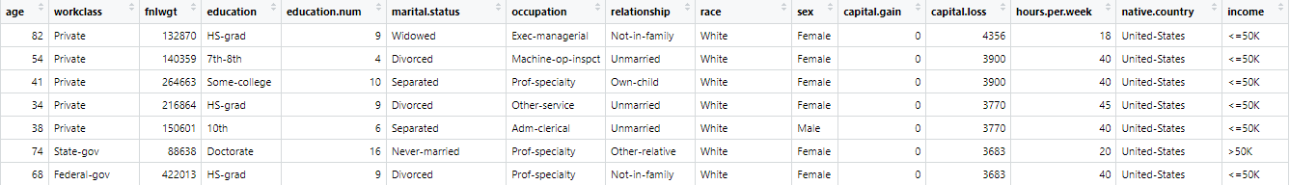
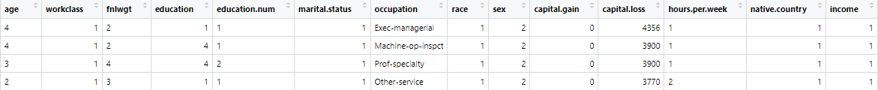
Giving categories
Transforming character data into categorical variables. This transformation will make our data set more compatible with more statistical techniques. Categorizing each character column to numerical codes, simplifying data while retaining its essential information. This process enhances our dataset’s suitability for statistical analysis, setting the stage for deeper exploration and insights.

Slide 14
Occupation Feature
Occupation column contains extensive list of diverse categories, making it impractical to transform into traditional categories variables. To overcome this problem I decided to generate new columns, each representing a specific occupation category. By implying this technique it is easier to transform complex occupation data into binary values. For each occupation, a new column is assigned with binary values such as True and False.

Slide 15
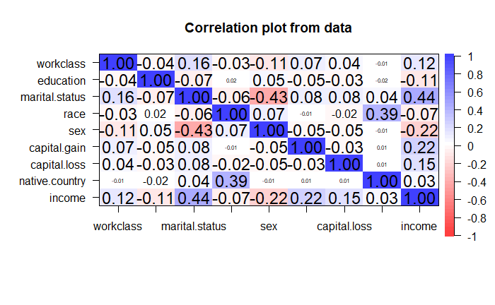
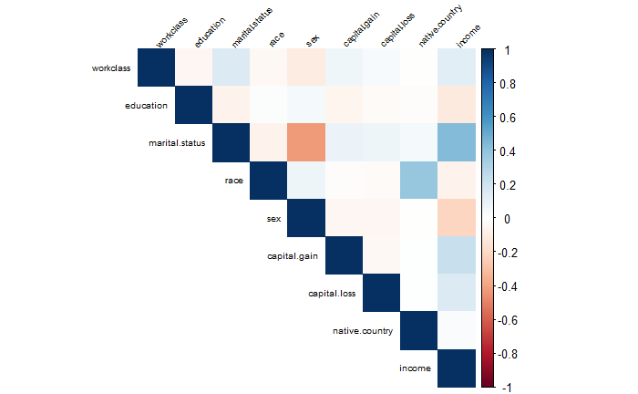
Correlating data
Objective of this was to discern which features within the dataset held the most relevance and which ones were less informative. This process allows us to gain insights into the interrelationships between different variables. It is important to eliminate less influential features to reduce dimensionality and enhancing the efficiency of our analysis. This approach to data reduction ensures to focus more on critical aspects of data.

Slide 16
Data Visualizing

Slide 17
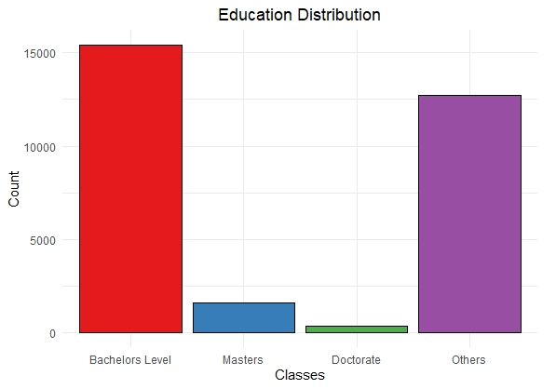
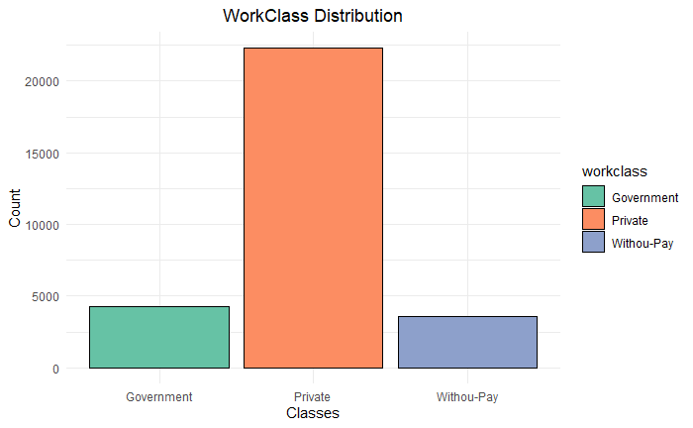
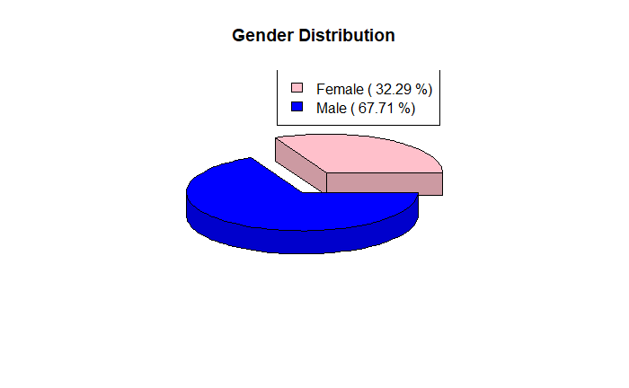
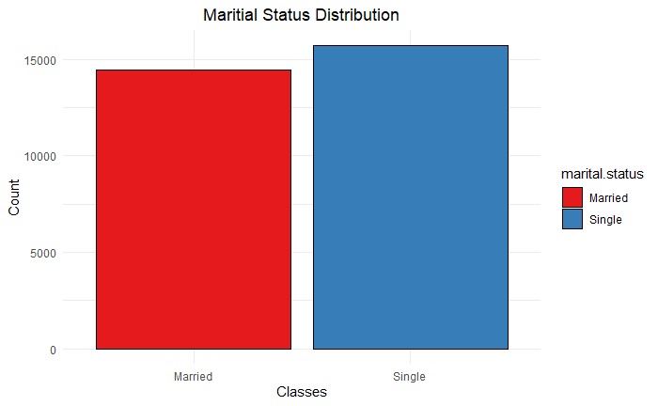
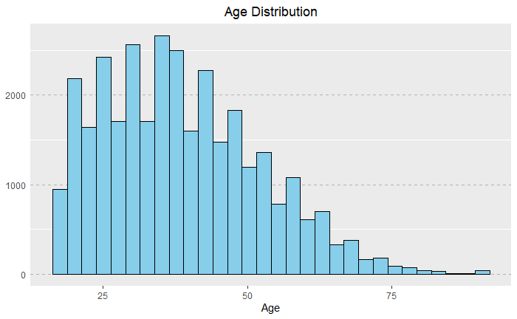
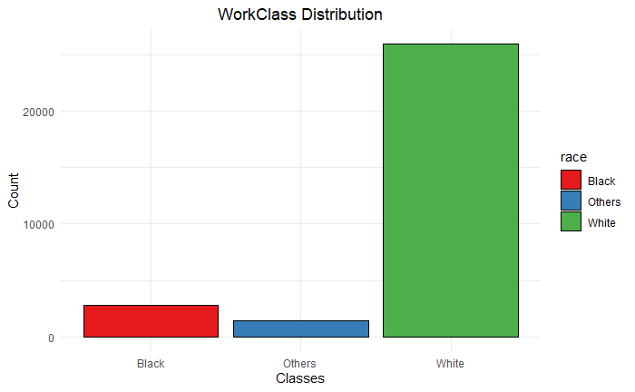
Overview of data

Slide 18
Problem Statement
Binary Classification
Targeting Services
The dataset contains demographic and socioeconomic attributes, and the main problem is to build a predictive model that classifies individuals into two income groups based on a threshold income level
The primary goal is to assist in resource allocation and financial planning by accurately identifying individuals at risk of low income, enabling targeted services and interventions.

Slide 19
Methodology

Slide 20
Algorithms
Decision Trees: They create a tree like structure where each internal node represents a decision, and each leaf node represents the outcome.
Random Forest: An ensemble learning method that combines multiple decision tree to improve predictive accuracy. It reduces overfitting by introducing randomness in the tree-building process.
Support Vector Machines: It can handle high-dimensional data and is effective for both linear and non-linear classification problems. It aims to maximize the margin between classes,making it robust and accurate.
Naïve Bayes: This is a probabilistic algorithm that relies on Bayes’ Theorem for classification. It assumes that features are independent, which simplifies the calculations.
Logistics Regression: This algorithm models relationship between the dependent binary variable and one or more independent variables. It provides probability score for each observation, which can be used to make predictions.

Slide 21
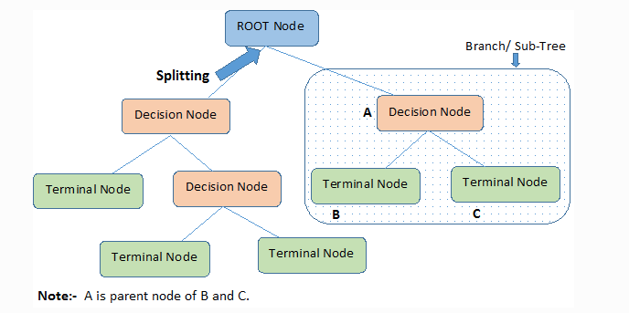
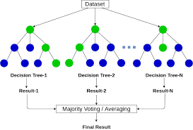
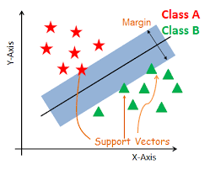
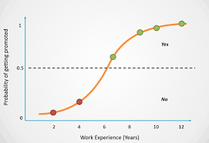
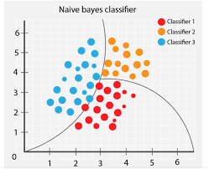
Visual Representation of algorithms
Decision Trees
Random Forest
Support Vector Machines
Logistic Regression
Naïve Bayes Classifier

Slide 22
Result Dataset
Dataset_Number | Model | Train_Accuracy | Test_Accuracy
1 | Decision_Tree | 0.874 | 0.840
2 | Decision_Tree | 0.875 | 0.836
1 | Random_Forest | 0.873 | 0.851
2 | Random_Forest | 0.876 | 0.849
1 | Support_Vector | 0.844 | 0.843
2 | Support_Vector | 0.843 | 0.846
1 | Naïve_Bayes | 0.798 | 0.802
2 | Naïve_Bayes | 0.797 | 0.799
1 | Logistic_Regression | 0.844 | 0.843
2 | Logistic_Regression | 0.847 | 0.840

Slide 23
FUNDING
$14,000
$12,000
$82,000
$32,000
ANGEL INVESTMENTS
PROPERTY
SHARES
CASH
Amount obtained through other investors
Revenue obtained from property rentals
Number of shares converted into USD
Liquid cash we have on hand

Slide 24
Use Cases
Credit scoring
Financial institutions can use the analysis to assess an individual's creditworthiness. By considering income, employment, and other factors, they can make informed decisions on lending and setting interest rates.
Marketing
Companies can target their marketing efforts more effectively by understanding the income and demographic profiles of their customers. This can lead to personalized advertising and product recommendations.
Government policy
Governments and policymakers can use the analysis to design and evaluate social programs, tax policies, and measures aimed at reducing income inequality or improving economic conditions for specific demographic groups.
Education planning
Educational institutions can use the information to create targeted scholarship programs, improve educational outcomes, and provide resources to students from underprivileged backgrounds.

Slide 25
SUMMARY
At Contoso, we believe in giving 110%. By using our next-generation data architecture, we help organizations virtually manage agile workflows. We thrive because of our market knowledge and great team behind our product. As our CEO says, "Efficiencies will come from proactively transforming how we do business.”

Slide 26
THANK YOU
Mirjam Nilsson​
206-555-0146
mirjam@contoso.com
www.contoso.com

